Slide 1
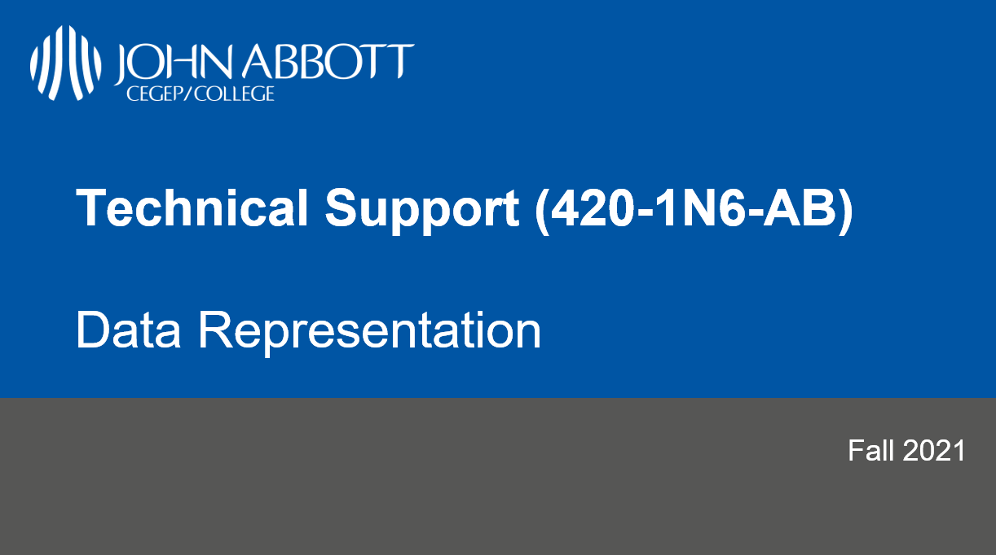

Slide 2
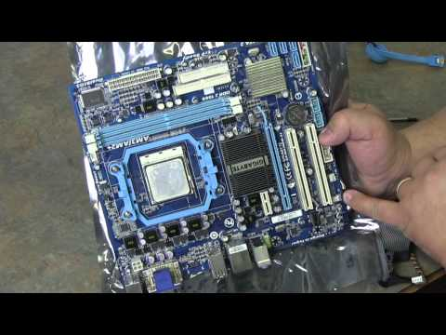
Video: Taking A Computer Apart
(28 mins)

Slide 3
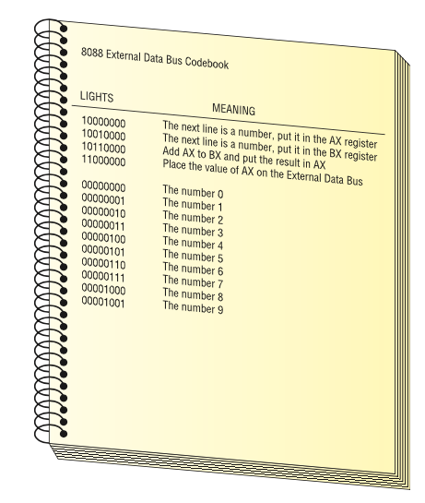
CPU Core Components: Activity
Using the following codebook, ask the “Man in a box” to calculate 2+3
You must send a series of commands to the CPU. The CPU will act on each command and give you an answer.

Slide 4
CPU Core Components: Activity (cont.)
10000000 The next line is a number, put it in the AX register 00000010 The number 2 10010000 The next line is a number, put it in the BX register 00000011 The number 3 10110000 Add AX to BX and put the result in AX 11000000 Place the value of AX on the external data bus
A set of commands such as this is called a program. A program is a series of command sent to a CPU in a specific order for the CPU to perform work.

Slide 5
CPU Core Components: Activity (cont.)
Try it yourself:
Using the following codebook, ask the “Man in a box” to calculate 8 + 7
What parts of the previous program stay the same? What parts of the previous program need to change?

Slide 6
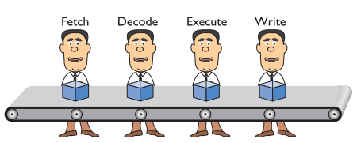
Pipelining
The CPU takes at least four stages (fetch, decode, execute, write/repeat) to do something. See https://en.wikipedia.org/wiki/Instruction_cycle for more detail Small discrete circuits inside the CPU handle each of these stages.
By organising these circuits in a conveyor-belt fashion (called pipelining), our “man-in-a-box” becomes “men-in-a-box”, thus improving efficiency.
Helps system to run faster. Not perfect and sometimes stalls. Some CPUs therefore have multiple pipelines.

Slide 7
More Hardware Components to Discuss
More on CPU.
GPU.
Memory
Storage Devices.
In the near future!

Slide 8
Binary System

Slide 9
Outline
Binary System
Representing Numbers in Binary
Representing Negative Numbers in Binary
Representing Text in Binary
Hexadecimal Numbers
Boolean Logic & Logical Gates
Binary Math

Slide 10
The Binary System
Everyone “knows” that computers use “binary” to operate
But, as we saw last class, computers don’t “know” anything -- ultimately, its CPU is just configured to react in particularly sophisticated ways when its switches (the lightbulbs) are turned on or off
So what is binary anyway? And what does it have to do with computers?

Slide 11
The Binary System
In order to understand the Binary numeral system, we can compare it to something we already know: the Decimal numeral system.
In decimal, numbers are represented by combinations of ten different symbols: (0, 1, 2, 3, 4, 5, 6, 7, 8, 9). We call decimal a base 10 numeral system.
If we have more than “9” of something, another digit is needed:
9 + 1 = 10
99 + 1 = 100, etc.
How do we represent numbers in binary?

Slide 12
The Binary System
In binary, there are only two symbols (0, 1). We call binary a base 2 numeral system. So if we have more than “1” of something, another bit is needed:
1 + 1 = 10 (in english: one plus one equals two)
11 + 1 = 100 (in english: three plus one equals four)
It’s counterintuitive at first! But there’s nothing fundamentally different about binary than decimal -- we’re just more used to using decimal instead.

Slide 13
The Binary System
Since we’re reusing symbols from the decimal system, there is a convention to use subscript to disambiguate between different numeral systems
1₂ + 1₂ = 10₂ is the same as 1₁₀ + 1₁₀ = 2₁₀ is the same as one plus one equals two
11₂ + 1₂ = 100₂ is the same as 3₁₀ + 1₁₀ = 4₁₀ is the same as three plus one equals four
This is not always required, but can be useful when the numeral systems are mixed in the same context.

Slide 14
The Binary System
Note: binary and decimal are not the only possible numeral systems. All that distinguishes numeral systems is the number of symbols you agree to use to represent numbers -- there are infinite possible numeral systems!
Hexadecimal is another useful numeral system (16 symbols, or base 16) which we will discuss later

Slide 15
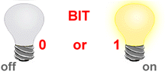
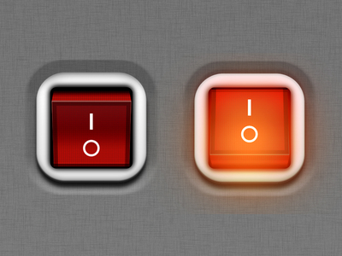
BIT – BInary digiT
So what does Binary have to do with computers?
Bit (Binary Digit) is the basic unit of information representing one of two discrete states.
The smallest unit of information within the computer.
Bit has one of two values:
0 (off) or 1 (on)
0 (False) or 1 (True)

Slide 16
How are Bits Represented in a Computer?
A transistor that is switched on or off
A capacitor that is charged or discharged.
On magnetic disks bits are represented by direction of the magnetic field (N-S, S-N).
Optical discs store bits optically (a bit on the surface is either shiny or not shiny).
Data is transmitted over telephone line or radio link using high- and low-pitched tones.
0
1
1
0
1
0
0
0
1
0
1
1
0
1
0
1

Slide 17
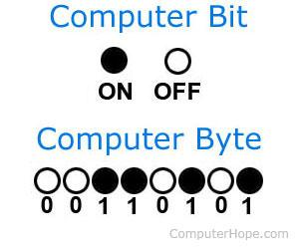
Byte
A Byte is a collection of bits known as the unit of digital information.
1 Byte = 8 bits
Abbreviation: B

Slide 18
Byte History
The byte represents the number of bits used to encode one character in a computer and hence it is the smallest addressable unit of memory in several computer architectures.
Size of a byte has been hardware dependent and no definitive standards existed that mandated the size.
A standard was introduced in 1993 that is common now.
1 byte = 8 bits

Slide 19
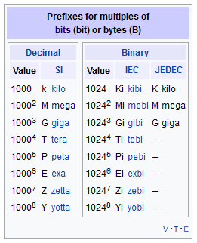
Byte Sizes
1 byte (B)
Kilobyte (KB) = 1,024 bytes (2¹⁰)
“one thousand bytes”
1,024 = 2 * 2 * 2 * 2 * 2 * 2 * 2 * 2 * 2 * 2
Megabyte (MB) = 1,048,576 bytes (2²⁰)
“one million bytes”
Gigabyte (GB) = 1,073,741,824 bytes (2³⁰)
“one billion bytes”
https://en.wikipedia.org/wiki/Byte

Slide 20
Representing Numbers in Binary

Slide 21
Converting Decimal Number to Binary
Divide a given decimal number by 2 using long division.
Note down the outcome and remainder of the division on the side.
Repeat steps 1 and 2 on the outcome until the outcome becomes zero.
The binary number will be the series of the remainders in the step 2.

Slide 22
Exercise: Converting Decimal Number to Binary
Convert 107 to binary.
double check you have the correct answer! google “107 in binary”

Slide 23
Recap Questions
True or False, expansion slots allow to expand the functionality by mainly plugging multiple motherboards together?
Two bridges compose the chipset on the motherboard, how are they called?
Buses are to bits as highways are to … and the buses speed is analogous to …?

Slide 24
Recap Questions
True or False, the CPU is a peripheral device connected to the motherboard through an expansion slot?
The CPU takes at least X stages to do a task, what is X?
True or False, these pipelines can fail, so some CPUs have parallel pipelines for backup?
How do we call the wire that turns on/off to indicate to the CPU to move to the next task?

Slide 25
Recap Binary
Computers “think” in binary (1/0)
Bit vs Byte
Kilobyte (KB) = 1,024 bytes (2¹⁰)
“one thousand bytes”
1,024 = 2 * 2 * 2 * 2 * 2 * 2 * 2 * 2 * 2 * 2
Megabyte (MB) = 1,048,576 bytes (2²⁰)
“one million bytes”
Gigabyte (GB) = 1,073,741,824 bytes (2³⁰)
“one billion bytes”

Slide 26
Recap Binary
Covert 25 to binary.
Long Division (divide the Outcome by 2 at every step):
Steps | Outcome | Remainder
1 | 25 | 1
2 | 12 | 0
3 | 6 | 0
4 | 3 | 1
5 | 1 | 1
Stop | 0
(25)₁₀ = (11001)₂

Slide 27
Exercises: Converting Decimal to Binary
Convert the following into binary:
10
64
128
146
300
1010
?
1000000
10000000
10010010
100101100

Slide 28
Recap Binary
Find the power of 2 value for each bit of the binary number, starting from 0. (e.g., the power of 2 value for the 5th bit of a binary number: 2⁵=32, etc.)
Add all the powers of two wherever there is a 1 in the bit of the binary number
The sum of the powers of two above is the value of the binary number in decimal!
Binary Number | 1 | 1 | 0 | 0 | 1
Step 1 | 4 | 3 | 2 | 1 | 0
Step 2 | 2⁴ | 2³ | 2² | 2¹ | 2⁰
 | 16 | 8 | 4 | 2 | 1
Step 3 | 16 + 8 + 1 = 25

Slide 29
Exercise: Converting Binary to Decimal
Convert the following binary numbers to decimal:
1001
1101101
1000001
1111111
100000011000001
1001= 1x 2³ + 0 x 2² + 0 x 2¹ + 1x 2⁰ = 9
?
1101101= 1 x 64 + 1 x 32 + 1x 8 + 1 x 4 +1x 1 = 109
1000001 = 1 x 1 + 1 x 64 = 65
1111111 = 1 x 1 + 1 x 2 + 1 x 4+ 1 x 8 + 1 x 16 + 1 x 32 + 1 x 64 = 127*
16577 = 1 x 1 + 1 x 64 + 1 x 128 + 2¹⁴ = 255 +16384 = 16 639
Notes:
* Little trick to speed up the calculation: since all the binary values are 1, you can add determine 1111111 + 1 = 10000000 -­> 2⁷ = 256 , so 1111111 = 10000000 – 1 = 256 -1 = 255.

Slide 30
How many Numbers can I represent?
1 bit 🡪 can represent 2 numbers
(0)₂ = (0)₁₀
(1)₂ = (1)₁₀
2 bits 🡪 can represent 4 numbers
(00)₂ = (0)₁₀
(01)₂ = (1)₁₀
(10)₂ = (2)₁₀
(11)₂ = (3)₁₀
Values: 0 to 3 in decimal.

Slide 31
n Bits ⬄ How many Numbers
Exercise
How many numbers can I represent in 4 bytes? What is the first and last number?
n bits
Can represent 2^{n} numbers
Values: from 0 to (2^{n} -1)
1 Byte 🡪 8 bit 🡪 2⁸ numbers (256)
First Number 0000 0000₂ = (0)₁₀ to
Last Number 1111 1111₂ = 2⁸-1 = (255)₁₀

Slide 32
Binary Math & Representing Negative Numbers

Slide 33
Decimal Math: Addition
10,000’s 1,000’s 100’s 10’s 1’s
1 6 5 1 0
+ 1 6 5 9 5
-----------------------------
3 3 1 0 5
1 1 1

Slide 34
Binary Math: Addition
64’s 32’s 16’s 8’s 4’s 2’s 1’s
1 1 1 0 1 0
+ 1 1 0 1 1
-----------------------------
1 0 1 0 1 0 1
Double check using the decimal numbers.
Dec
58
+ 27 -------
85
1 1 1 1

Slide 35
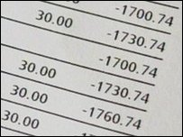

Negative Numbers
Not all numbers are positive.
Winter weather temperatures in Canada ☹
Bank accounts … ☹☹☹
Computers need to represent both positive and negative numbers.

Slide 36
Negative Numbers
In computers, an integer number is represented using
32 bits (4 bytes)
32 bits can represent: 2³² - 1 = 4,294,967,295 numbers
Most computers use the first bit for the sign:
1 for negative
0 for positive
Use the remaining 31 bits for the number itself

Slide 37
Simple Way
32 bits
1 bit for the sign
31 bits = 2³¹ - 1 = 2,147,483,648 numbers
Example:
Decimal Binary
173 00000000 00000000 00000000 10101101
-173 10000000 00000000 00000000 10101101

Slide 38
Simple Way: Representation with 4 bits
There are some problems with the “Simple Way”, however....
What happens when we do math?
( 5 )
+ ( -5 )
-----------
( 6 )
+ ( -2 )
-----------
1 1 1 1 -7
1 1 1 0 -6
1 1 0 1 -5
1 1 0 0 -4
1 0 1 1 -3
1 0 1 0 -2
1 0 0 1 -1
1 0 0 0 -0 Negative zero??
0 0 0 0 0 Zero appears twice!
0 0 0 1 1
0 0 1 0 2
0 0 1 1 3
0 1 0 0 4
0 1 0 1 5
0 1 1 0 6
0 1 1 1 7

Slide 39
Fixing the “Simple” Method: Two’s Complement
Two’s complement is another way computers represent negative numbers.
Basic idea:
we still use the left-most bit to indicate whether a number is positive (0) or negative (1)
BUT: we convert the rest of the bits into the “complement” (negative image) of the positive number. For reasons that have to do with “set theory” (i.e. not important for this class), we will be able to perform normal mathematical operations we would expect to do with negative numbers.

Slide 40
Fixing the “Simple” Method: Two’s Complement
Process: how to represent (-5)₁₀ in binary using two’s complement:
Find the binary value for the positive value of the given number, using all the bits made available to us (so if there is one byte, use all 8 bits)
(5)₁₀ = (0000 0101)₂
Invert all the bits in step 1:
0000 0101 🡪 invert 🡪 1111 1010
Add 1 to the inverted value
Inverted binary = 010 + 1 🡪 (-5)₁₀ = (1111 1011)₂

Slide 41
Two’s Complement: Representation with 4 bits
1 0 0 0 -8
1 0 0 1 -7
1 0 1 0 -6
1 0 1 1 -5
1 1 0 0 -4
1 1 0 1 -3
1 1 1 0 -2
1 1 1 1 -1
0 0 0 0 0
0 0 0 1 1
0 0 1 0 2
0 0 1 1 3
0 1 0 0 4
0 1 0 1 5
0 1 1 0 6
0 1 1 1 7
Let’s do some math operations:
( 5 )
+ ( -5 )
-----------
( 6 )
+ ( -2 )
-----------

Slide 42
Representing Text

Slide 43
Problem:
I want to write the following message in terms of 0 and 1:
How would you do it?
Hello World

Slide 44
Text in Computers
In early years, different computer companies applied the binary system in their own way.
The word “cat” would be encoded in binary different on different brands of computers.
This made life difficult in terms of being able to transfer data from one system to another.

Slide 45
ASCII
ASCII (American Standard Code for Information Interchange)
Standard introduced that used a 7 bit code with 128 combinations.
Later became 8-bits (256 combinations) – ASCII-8.
Why eight bits?
So each character can be stored in a single byte.
CAT 0100 0011 0100 0001 0101 0100
cat 0110 0011 0110 0001 0111 0100

Slide 46
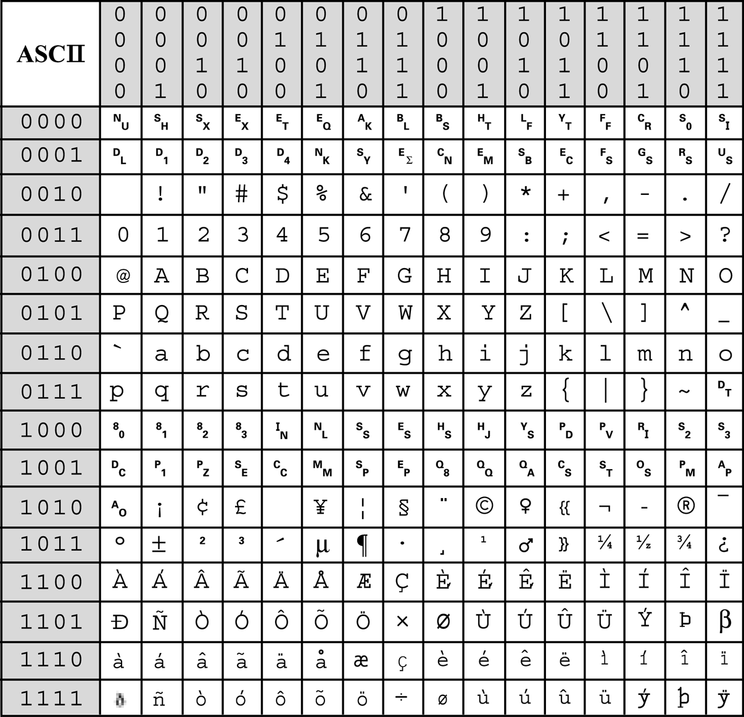
ASCII-8
Decode the following message
01000001 01010011 01000011 01001001 01001001 00100000 01101001 01110011 00100000 01101100 01101001 01101101 01101001 01110100 01100101 01100100

Slide 47
Unicode
Although ASCII works fine for English, many other languages need more than 256 characters, including numbers and punctuation.
Unicode is a computing industry standard for the consistent encoding, representation, and handling of text expressed in most of the world's writing systems and operating systems.
The Unicode standard defines UTF-8, UTF-16, and UTF-32, and several other encodings are in use.

Slide 48
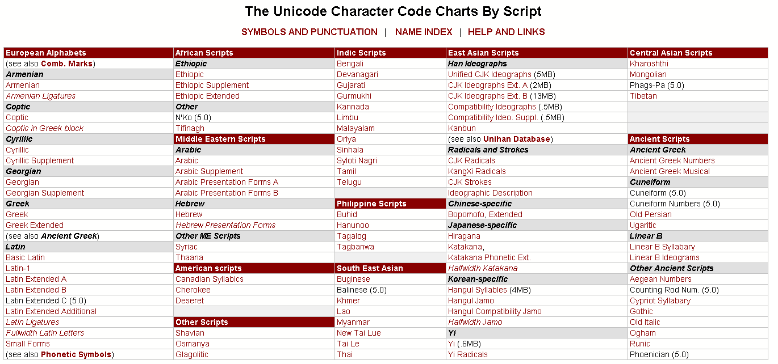
Unicode

Slide 49
Boolean Logic & Logic Gates

Slide 50
Boolean Operations
Integrated Circuits (microchips) are used to store and manipulate (process) bits.
Bits can be manipulated using Boolean Operations.
Boolean algebra: the mathematics of digital logic and Boolean operations.
Name Boolean for mathematician George Boole
Useful in dealing with binary systems where a variable can have a false of 0 or 1 (true or false).
Uses Boolean operations to manipulate one or more Boolean values.
Used in the analysis and synthesis of logical expressions.

Slide 51
Logic in Electronics
Electrical circuits are designed to represent logical expressions
Known as logic circuits.
Used to make important logical decisions in household appliances, computers, communication devices, traffic signals and microprocessors.
Four basic logic operations listed below:
OR operation
AND operation
NOT operation
XOR operation (eXclusive Or)

Slide 52
Logic Gates
A logic gate is an electronic circuit/device which makes the logical decisions based on these operations.
Logic gates have:
One or more inputs
Only one output
Computes a Boolean operation.
The output is active only for certain input combinations.
Logic gates are the building blocks of any digital circuit.

Slide 53
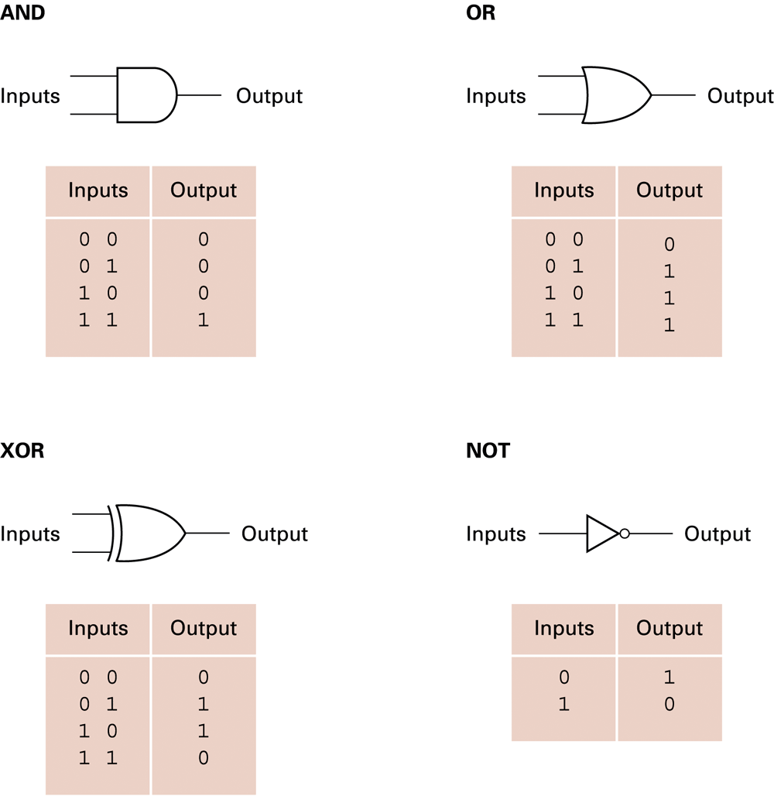
Logic Gate & Truth Tables
Using Truth Tables we can use different sets of logic operations to store, add, subtract, and perform more complicated operations with bits.

Slide 54
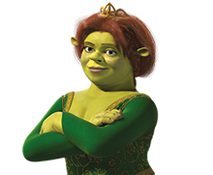
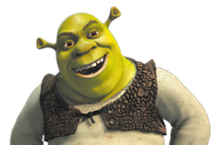
Boolean Operations: AND
TRUE
TRUE
AND
=TRUE
AND Operation
Both input values must be TRUE for output to be TRUE
Shrek is an ogre AND Fiona is a princess
Both inputs are TRUE, so the output is TRUE

Slide 55


Boolean Operations: AND Gate
Truth Table
Inputs Outputs
0 0 0
0 1 0 0 = FALSE
1 0 0 1 = TRUE
1 1 1
AND Operation
Both input values must be TRUE for output to be TRUE
0
0
0
0
0
1
1
0
0
1
1
1

Slide 56
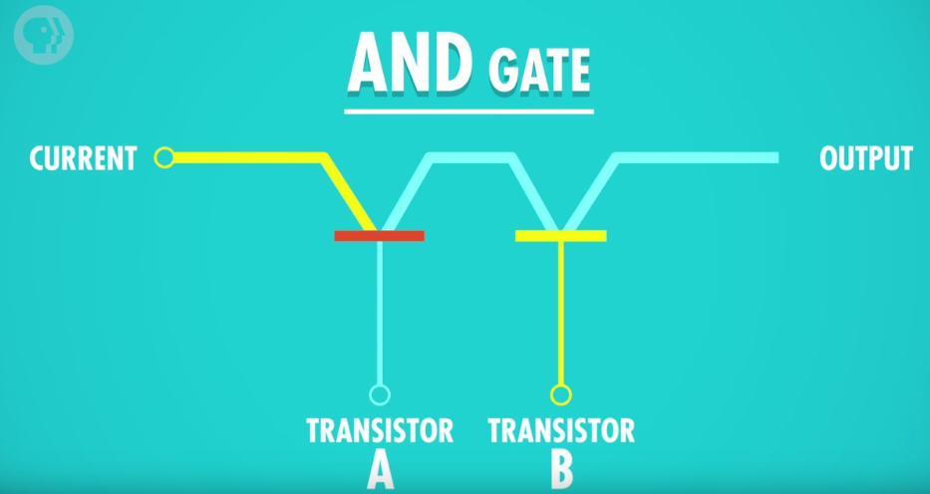
AND Gate
To build an AND gate: Two transistors connected together
Two inputs (transistors A and B) and one output
Transistor A: Off (False)
Transistor B: On (True)
Output: Off (False)
Off (False)
Off (False)
On (True)

Slide 57
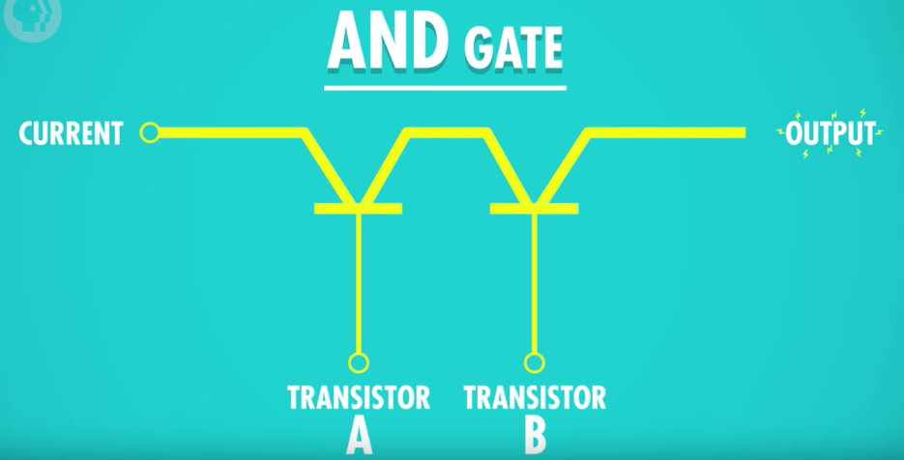
AND Gate
Transistor A: On (True)
Transistor B: On (True)
Output: On (True)
On (True)
On (True)
On (True)

Slide 58
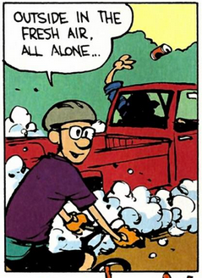

Boolean Operations: OR
= FALSE
OR
FALSE
FALSE
OR Operation
Both input values must be FALSE for output to be FALSE
If Michael likes traffic OR Michael takes the train to work every day ☹. 🡪 False or False = False
Both inputs must be FALSE for an OR expression to be FALSE.
If Michael is to change his habits and use public transit 🡪 expression becomes true. (One true is enough)

Slide 59

Boolean Operations: OR Gate
Truth Table
Inputs Outputs
0 0 0
0 1 1 0 = FALSE
1 0 1 1 = TRUE
1 1 1
OR Operation
At least one input value must be TRUE for output to be TRUE
0
0
0
0
1
1
1
1
0
1
1
1

Slide 60
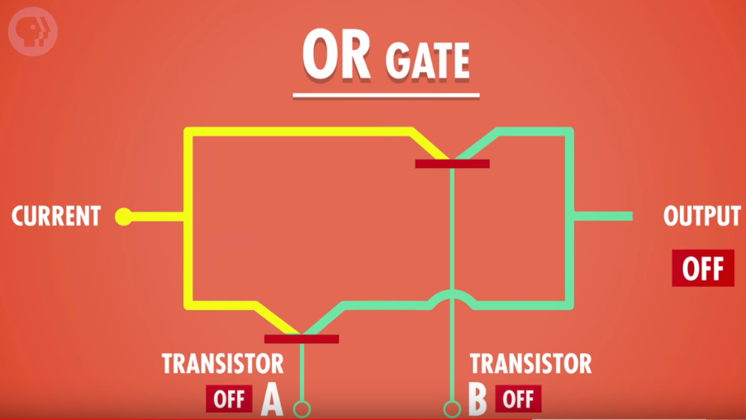
OR Gate
Two inputs (transistors A and B) and one output.
Transistor A: Off (False)
Transistor B: Off (False)
Output: Off (False)

Slide 61
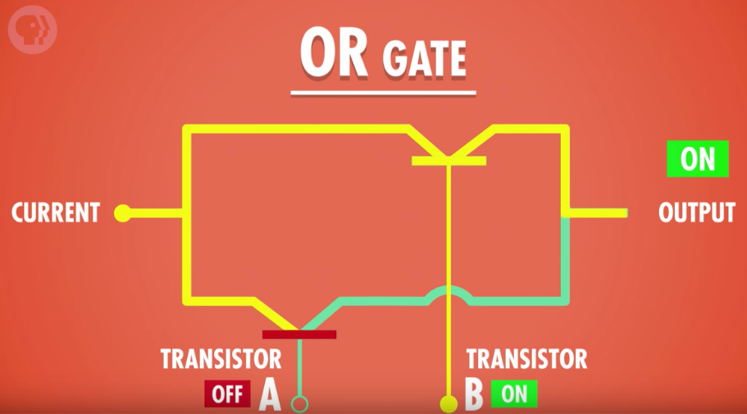
OR Gate
Two inputs (transistors A and B) and one output
Transistor A: Off (False)
Transistor B: On (True)
Output: On (True)

Slide 62

Boolean Operations: NOT
Truth Table
Inputs Outputs
0 1 0 = FALSE
1 0 1 = TRUE
NOT Operation
Only one input
Opposite of input (inverts input)
NOT FALSE = TRUE
NOT TRUE = FALSE
0
1
1
0

Slide 63
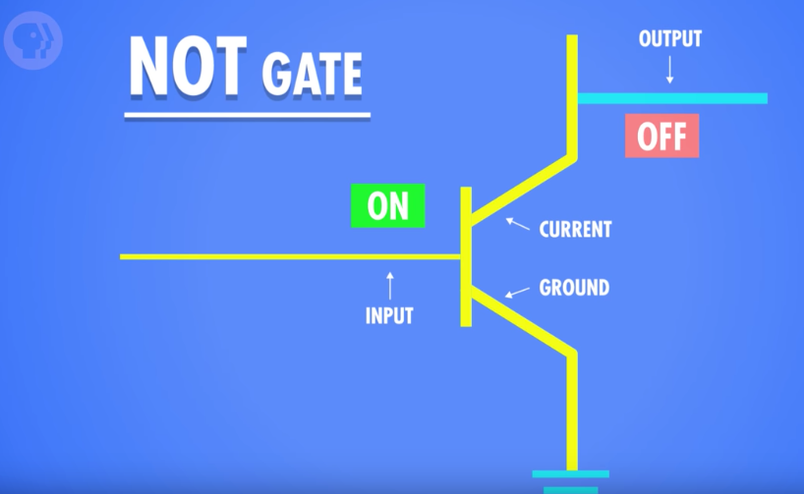
NOT Gate
To build an NOT gate: One transistor
One input and one output
Transistor A: On (True)
Current flows to ground wire and none to output, so output is Off (False)

Slide 64
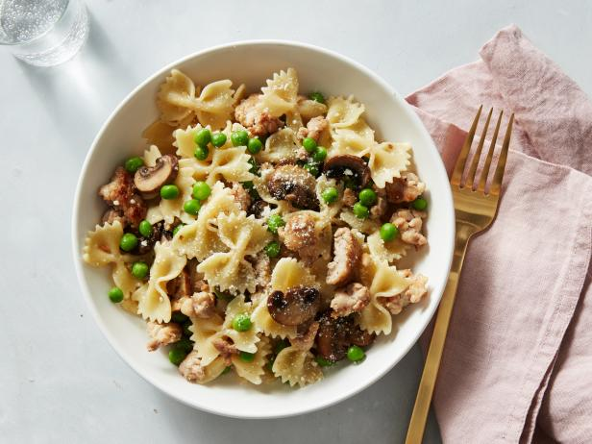

Boolean Operations: XOR
TRUE
FALSE
OR
=TRUE
XOR Operation (Exclusive OR)
One and ONLY one input value can be TRUE for output to be TRUE
At noon Michael is going for lunch XOR Michael is going to class
If both were true, the output would be false! (as I cannot do both at the same time).
If both were false, the output will still be false

Slide 65

Boolean Operations: XOR Gate
0
Truth Table
Inputs Outputs
0 0 0
0 1 1 0 = FALSE
1 0 1 1 = TRUE
1 1 0
XOR Operation
Only one input value is TRUE for output to be TRUE
0
0
0
1
1
1
1
0
1
0
1

Slide 66
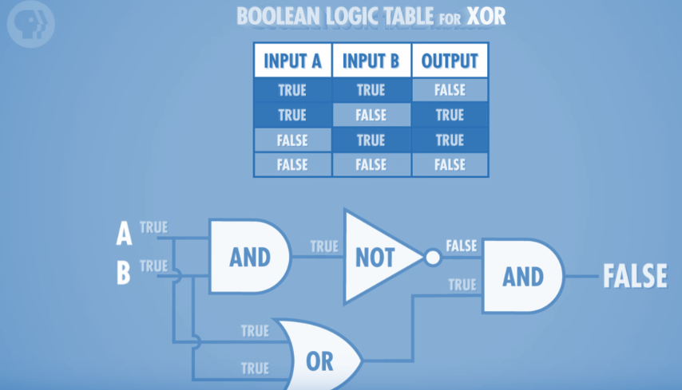
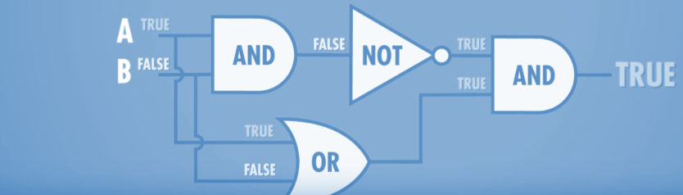
XOR Gate
How to build an XOR gate? We can’t do it directly with transistors-- but we can by combining AND, OR, and NOT gates!
Both of the images above are the same combination of gates; the only difference is the input values

Slide 67
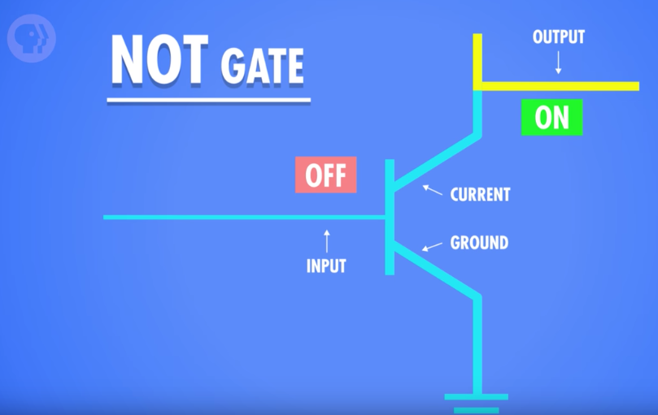
NOT Gate
Transistor A: Off (False)
Current flows to the output wire, so output is On (True)

Slide 68
Binary Math

Slide 69
Decimal Math: Addition
10,000’s 1,000’s 100’s 10’s 1’s
1 6 5 1 0
+ 1 6 5 9 5
-----------------------------
3 3 1 0 5
1 1 1

Slide 70
Binary Math: Addition
64’s 32’s 16’s 8’s 4’s 2’s 1’s
1 1 1 0 1 0
+ 1 1 0 1 1
-----------------------------
1 0 1 0 1 0 1
Double check using the decimal numbers.
Dec
58
+ 27 -------
85
1 1 1 1

Slide 71
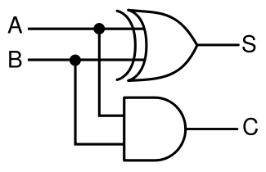
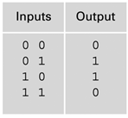
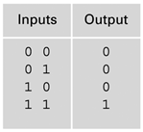
Half Adder Gate: Adding two bits
Inputs: A, B
S = Sum
C = Carry
A + B = 2’s 1’s

Slide 72
Half Adder Gate: Adding two bits
Inputs: A, B
S = Sum
C = Carry
A + B = 2’s 1’s
0 + 0 = 0 0
0 🡪
0
0 🡪
0

Slide 73
Half Adder Gate: Adding two bits
Inputs: A, B
S = Sum
C = Carry
A + B = 2’s 1’s
0 + 1 = 0 1
0 🡪
1
1 🡪
0

Slide 74
Half Adder Gate: Adding two bits
Inputs: A, B
S = Sum
C = Carry
A + B = 2’s 1’s
1 + 0 = 0 1
1 🡪
1
0 🡪
0

Slide 75
Half Adder Gate: Adding two bits
Inputs: A, B
S = Sum
C = Carry
A + B = 2’s 1’s
1 + 1 = 1 0
1 🡪
0
1 🡪
1

Slide 76
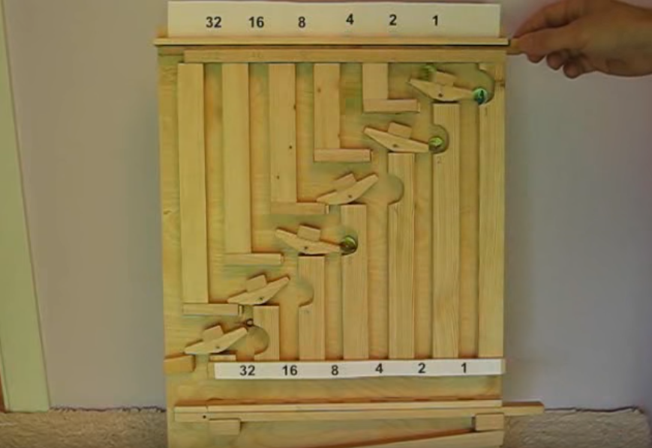
Marble Adding Machine
http://www.youtube.com/watch?v=GcDshWmhF4A&NR=1&feature=fvwp

Slide 77
Hexadecimal Numbers

Slide 78
Hexadecimal Numbers
Hexadecimal number are base 16 numeric system.
Who uses the hexadecimal system?
Web designers.
Digital medial creators.
Computer scientists.
Networking professionals.

Slide 79
Building Hexadecimal Numbers
Decimal | Hex (16’s column) | Hex (1’s column)
0 | 0 | 0
1 | 0 | 1
2 | 0 | 2
3 | 0 | 3
4 | 0 | 4
5 | 0 | 5
6 | 0 | 6
7 | 0 | 7
8 | 0 | 8
everything is the same so far...

Slide 80
Building Hexadecimal Numbers
Decimal | Hex (16’s column) | Hex (1’s column)
9 | 0 | 9
10 | 0 | A
11 | 0 | B
12 | 0 | C
13 | 0 | D
14 | 0 | E
15 | 0 | F
16 | 1 | 0
17 | 1 | 1
here is where it gets interesting!

Slide 81
Building Hexadecimal Numbers
Decimal | Hex (16’s column) | Hex (1’s column)
18 | 1 | 2
19 | 1 | 3
20 | 1 | 4
21 | 1 | 5
22 | 1 | 6
23 | 1 | 7
24 | 1 | 8
25 | 1 | 9
26 | 1 | A
etc. etc.

Slide 82
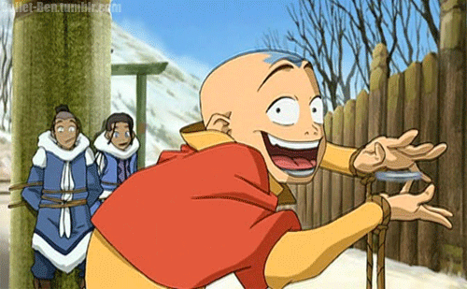
Question
Avatar Aang went to get his first driving license. The clerk asked Aang for his ID to make sure he was old enough to do the driving test. The clerk told him that he needs to be at least 18. Aang answered, “I’m sorry but you are wrong. I am exactly 18. My ID shows my age in Hexadecimal.”
What age is Aang in Hexadecimal?
Decimal 16’s 1’s
18

Slide 83
Why Hexadecimal?
Hexadecimal is perfect for matching 4 bits.
Every combination of 4 bits can be matched with one hex number.
(why? think of powers of 2! How many symbols are there in hexadecimal, how many bits do you need to represent one hexadecimal digit?)
4 bits can be represented by 1 Hex value
8 bits can be represented by 2 Hex values

Slide 84
Hexadecimal Digits
Dec Hex Binary
0 0 0000
1 1 0001
2 2 0010
3 3 0011
4 4 0100
5 5 0101
6 6 0110
7 7 0111
Dec Hex Binary
8 8 1000
9 9 1001
10 A 1010
11 B 1011
12 C 1100
13 D 1101
14 E 1110
15 F 1111

Slide 85
What about 8 bits?
Dec. Hex. Binary Dec. Hex. Binary
0 0 0000 8 8 1000
1 1 0001 9 9 1001
2 2 0010 10 A 1010
3 3 0011 11 B 1011
4 4 0100 12 C 1100
5 5 0101 13 D 1101
6 6 0110 14 E 1110
7 7 0111 15 F 1111
-----------------------------------------------------
HEX BINARY
2 4 ?

Slide 86
What about 8 bits?
Dec. Hex. Binary Dec. Hex. Binary
0 0 0000 8 8 1000
1 1 0001 9 9 1001
2 2 0010 10 A 1010
3 3 0011 11 B 1011
4 4 0100 12 C 1100
5 5 0101 13 D 1101
6 6 0110 14 E 1110
7 7 0111 15 F 1111
-----------------------------------------------------
HEX BINARY
2 4 0010 0100

Slide 87
Using Hex for 8 bits
Dec. Hex. Binary Dec. Hex. Binary
0 0 0000 8 8 1000
1 1 0001 9 9 1001
2 2 0010 10 A 1010
3 3 0011 11 B 1011
4 4 0100 12 C 1100
5 5 0101 13 D 1101
6 6 0110 14 E 1110
7 7 0111 15 F 1111
-----------------------------------------------------
Hex Binary Hex Binary Hex Binary
12 0001 0010 3C 0011 1100 99 1001 1001
Exercise: Convert the following 8 bit (1 byte) hexadecimal numbers to binary
AB 1A 00
02 B4 7D

Slide 88
Hexadecimal # RED GREEN BLUE
<td rowspan="2" bgcolor="#cccc99"> </td>
Red Green Blue
cc cc 99
Convert to Binary
Red Green Blue
Hex cc cc 99
Bin 1100 1100 1100 1100 1001 1001
24 bits represent a single color

Slide 89
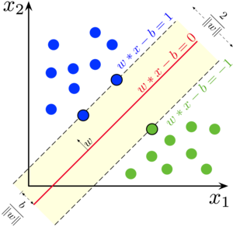
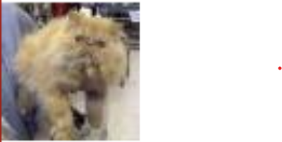
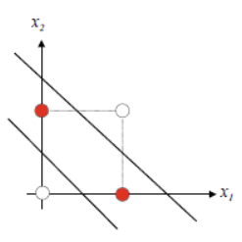

BONUS: About data representation in AI…
In Machine Learning we often want to be able to separate data in a simple way (straight line):
XOR problem requires two lines to separate the cats from dogs
Many AI models were developed since the 1950s but because of the failure case of the XOR logical gate, it took many more decades to make AI relevant again.

Slide 90
Q & A
Notes:
In Slide Show mode, click the arrow to enter the PowerPoint Getting Started Center.

